Slide 1



Winning the Mission: How Jet Club Outperforms Fractional and Charter
Notes:
Picture this: a prospect who just lost confidence in their charter broker after a last-minute aircraft swap, but feels equally uneasy about signing another multi-year fractional renewal. They want reliability, but they do not want to feel trapped. That tension is where Jet Club wins. Today’s private aviation customer is not the same buyer we were selling to five years ago, and that shift creates a massive opportunity for Jet Club. The market has expanded structurally since the pandemic, and access has overtaken ownership as the dominant buying motivation. Customers are flying more selectively, questioning long-term commitments, and demanding predictable outcomes without locking themselves into rigid programs. As a sales team, this moment matters because our competitors are selling yesterday’s solutions to today’s problems. Fractional ownership grew rapidly after the pandemic, but it did so by pulling customers into multi-year contracts, capital buy-ins, and fixed aircraft categories. Charter operators promise flexibility, yet often deliver price volatility, inconsistent aircraft quality, and unreliable availability. Buyers increasingly feel stuck between two imperfect options. Jet Club sits directly in the middle of this tension. We provide structure without rigidity, flexibility without chaos, and predictability without ownership risk. However, winning more deals requires us to clearly articulate that difference. We cannot assume customers understand our value automatically. We must lead with mission fit, data-backed comparisons, and confidence. This presentation is designed to give you that edge. We will break down our program, our aircraft, and our competitive positioning in a way that is easy to repeat in every sales conversation. By the end, you should feel equipped to control the narrative, anticipate objections, and guide prospects toward Jet Club as the smartest decision for how they actually fly. This is about improving close rates, shortening sales cycles, and positioning ourselves as trusted advisors rather than product sellers. The reps who master this story will consistently win against both fractional and charter alternatives. --- Requested Image: Market shift graphic showing access overtaking ownership --- DATA SOURCES Knowledge Base: 29 organizational facts/terms used Research Sources: - Private Jet Market Outlook 2024–2025 (industry_report) - Q2 2024 Business Aviation Market Brief (industry_report) - Private Jet Card Comparisons Pricing & Survey Data (industry_report) Key Facts: - "The global private jet market reached approximately $24.3B in 2025, growing at ~14.3% YoY, with North America representing ~60–63% of total demand." - Global Market Insights / The Business Research Company, 2024–2025 - "Fractional ownership programs grew approximately 60–70% YoY post-pandemic, but require multi-year contracts (3–7 years), capital buy-ins, and fixed aircraft categories." - Aviation market reports; Private Jet Card Comparisons, 2024–2025 - "Business aviation flight activity in 2024 remained ~14–29% above pre-COVID (2019) levels despite normalization from 2021–2022 peaks." - Global Jet Capital Q2 2024 Market Brief; Jefferies Equity Research - "Jet card programs reduced peak-day restrictions from ~45 days in 2024 to ~35 days in early 2025 while maintaining predictable hourly pricing." - Private Jet Card Comparisons (PJCC), April 2025 - "Average jet card hourly rates in Q1 2025 were ~$11,100, with Light Jets averaging ~$8,300 and Midsize Jets ~$9,800 including fuel and FET." - Private Jet Card Comparisons, Q1 2025 Pricing Data

Slide 2
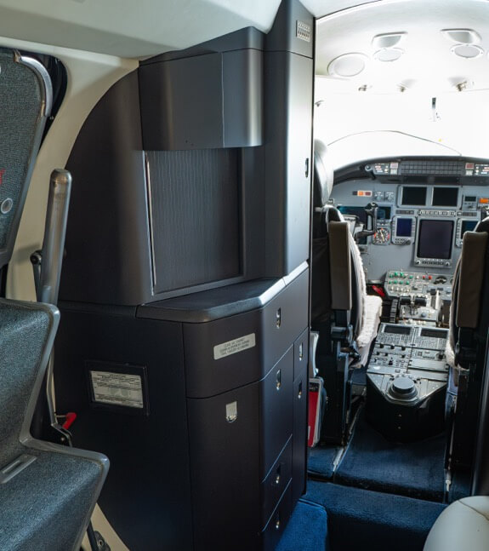
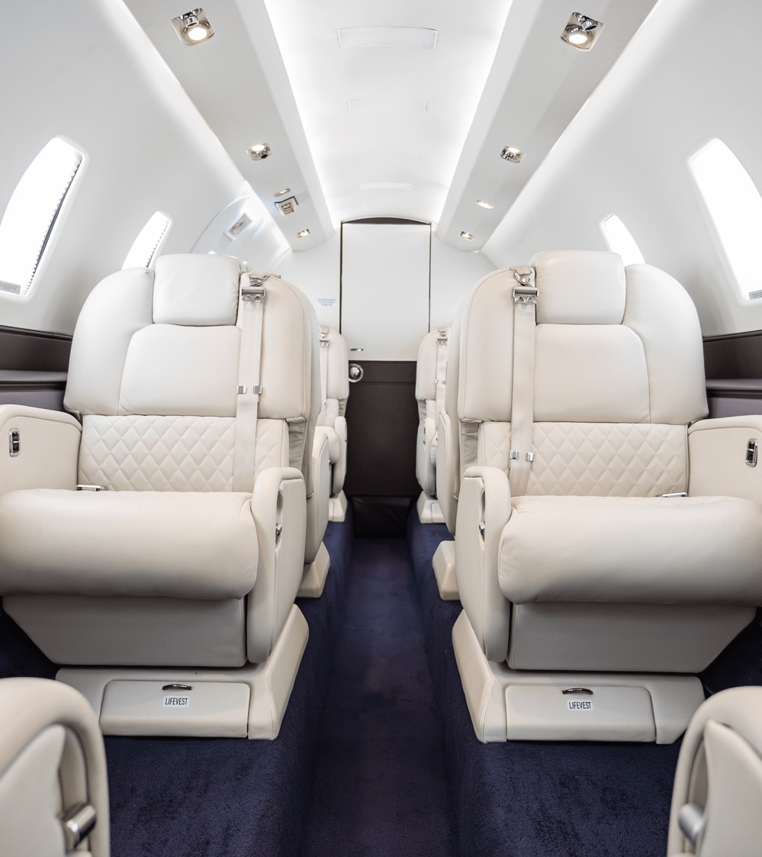
Jet Club Program Overview: The Core Value Proposition
Confidence grows when reps realize Jet Club solves problems customers already feel.
Jet Club delivers structured flexibility by combining predictable pricing, guaranteed access, and mission-aligned aircraft without ownership risk.
Customers buy flight hours rather than aircraft shares, allowing usage patterns to change without financial penalties or long-term lockups.
Concrete proof points make Jet Club easier for reps to explain and for customers to trust.
Notes:
Jet Club is designed around one central idea: every customer’s mission is different, and their aviation solution should adapt accordingly. Unlike fractional or charter models that force customers into predefined boxes, Jet Club provides structured flexibility that scales with how clients actually fly. At its core, Jet Club combines predictable pricing, guaranteed access, and a curated fleet without requiring ownership risk or long-term lockups. Customers purchase flight hours rather than aircraft shares, allowing them to adjust usage over time without being penalized. What this means in practice: - Typical agreements are shorter-term and renewable, not multi-year ownership contracts. - Access is guaranteed within defined booking windows, even during peak periods. - Pricing includes fuel and federal excise tax, reducing post-flight surprises. From a sales perspective, it is critical to emphasize that Jet Club is not just a jet card; it is a mission-fit access program. We remove the capital burden and depreciation risk of fractional ownership while eliminating the uncertainty and variability that plague charter experiences. When positioning Jet Club, avoid feature dumping. Lead with outcomes: fewer surprises, better aircraft matching, and the freedom to evolve without penalties. This reframes the conversation away from price comparisons and toward value alignment. --- Requested Image: Jet Club value triangle showing flexibility, predictability, and access
Image Credit: Image Library: Citation Excel XLS Jet Cockpit and Galley Interior

Slide 3
Understanding Customer Flight Missions
Reps feel empowered by leading conversations instead of reacting to price objections.
Effective Jet Club selling begins with diagnosing customer missions based on distance, passengers, frequency, and planning behavior.
Mission-first conversations reveal misalignment in fractional and charter models.
Advisory selling builds trust and reduces price-based objections.
Notes:
A Jet Club member flying quarterly board meetings across the Northeast has a very different mission than a family traveling seasonally to the West Coast. To sell Jet Club effectively, we must anchor every conversation around mission, not aircraft. A mission is defined by distance, passenger count, runway access, frequency, and tolerance for variability. Customers rarely articulate these dimensions clearly, which is where we add value. As sales reps, your job is to diagnose the mission before proposing a solution. Ask how often they fly, where they go most frequently, how many passengers typically travel, and how far in advance trips are planned. Once the mission is clear, Jet Club becomes the logical recommendation because it avoids overcommitting customers to a single aircraft type or ownership structure. You can confidently explain that Jet Club supports evolving missions without renegotiation or exit costs. Mission-first selling is the foundation of higher close rates. Customers trust solutions that reflect their reality, not assumptions. --- Requested Image: Mission profile checklist graphic

Slide 4
Jet Club Aircraft Categories and Mission Fit
Reps gain confidence explaining aircraft choices without technical overload.
Jet Club aircraft categories align to real-world missions, not one-size-fits-all ownership.
Right-sizing prevents overpaying or under-serving trips.
Flexibility across categories is a competitive advantage.
Notes:
One Jet Club customer summed it up perfectly: “I don’t want to pay for a big jet on short trips, and I don’t want to outgrow my program when trips get longer.” That is exactly the problem Jet Club’s aircraft strategy solves. Jet Club’s aircraft lineup is intentionally designed to cover the most common customer missions without excess complexity. Rather than locking buyers into one category, we enable right-sizing trip by trip. Light jets support short-haul regional travel. Midsize jets handle the majority of business aviation missions. Super-midsize and large-cabin aircraft serve longer, premium missions when required. The key sales message is contrast: overbuying versus right-sizing. Fractional programs lock customers into one category, while charter availability can be inconsistent. Jet Club flexes with the mission. This reinforces our mission framework and makes the cost-efficiency story intuitive. --- Requested Image: Right Aircraft vs Wrong Aircraft comparison graphic

Slide 5


The Private Aviation Market Reality
Private aviation activity remains well above pre-2019 levels.
Access-based models outperform ownership models in modern buyer psychology.
Jet Club aligns with long-term market direction.
Notes:
The data supports what customers are already telling us. Private aviation activity remains materially above 2019 levels, even after post-pandemic normalization. Access-based programs have captured a disproportionate share of that growth. This matters because buyer psychology has changed. Optionality now beats obligation. Customers want solutions that match real usage, not aspirational projections. Fractional growth exposed structural strain: more members competing for the same fleets, tighter policies, and more visible friction. Charter remains fragmented and unpredictable. These market realities reinforce why Jet Club is not just appealing, but aligned with where the industry is heading. --- Requested Image: Market growth trend line with data callout
Image Credit: Image Library: Private Business Jet in Flight

Slide 6
Fractional Ownership: Strengths and Structural Weaknesses
Fractional ownership locks buyers into rigid, long-term commitments.
Emotional pain often comes from feeling trapped after signing.
Jet Club restores flexibility without sacrificing structure.
Notes:
Many fractional buyers admit the same thing quietly: once they sign, they feel stuck. What looked premium upfront can feel restrictive over time. Fractional ownership offers structure and consistency, but at the cost of flexibility. Multi-year contracts, capital exposure, and fixed aircraft categories limit adaptability. Availability issues, interchange fees, and blackout periods often surface after commitment. Exiting can be slow, discounted, or impossible. Jet Club offers a way out of that trapped feeling. No ownership risk, shorter commitments, and mission flexibility make it feel modern by comparison. The goal is not to criticize, but to validate buyer regret and offer a better path forward. --- Requested Image: Fractional lifecycle vs Jet Club flexibility graphic

Slide 7


Charter: Flexibility on Paper, Uncertainty in Practice
Charter volatility frustrates frequent flyers.
Simple diagnostic questions surface pain quickly.
Jet Club delivers flexibility with reliability.
Notes:
A common charter story starts with excitement and ends with frustration. Prices change. Aircraft change. Expectations slip. Charter promises flexibility, but delivers volatility. Quality and availability vary, especially for frequent flyers. Diagnostic questions help surface this quickly: - “When was the last time your quoted price changed after booking?” - “How often do you get the exact aircraft you expected?” Jet Club keeps flexibility while removing uncertainty. That evolution resonates with experienced charter users. --- Requested Image: Charter vs Jet Club experience contrast
Image Credit: Image Library: Citation Excel XLS Mid-Size Jet on Runway with Mountain Backdrop

Slide 8
Jet Club vs Fractional vs Charter Comparison
Attribute | Jet Club | Fractional Ownership | Charter
Commitment Length | Short-term, renewable | 3–5 years | Trip-by-trip
Pricing Predictability | High | Medium | Low
Aircraft Flexibility | High | Low | Medium
Capital Risk | None | High | None
Notes:
All of this comes together in one simple comparison customers immediately understand. Side-by-side, Jet Club clearly occupies the middle ground: structure without rigidity and flexibility without chaos. This comparison should be framed as the decision-making centerpiece, not an afterthought. Clarity drives confidence. --- Requested Image: Comparison table

Slide 9
Pricing Predictability as a Sales Advantage
Predictability reduces approval friction.
Jet Club pricing removes surprises.
Peace of mind is a tangible benefit.
Notes:
Predictability reduces friction far beyond price. CFOs approve faster. Executive assistants plan with confidence. Families travel without stress. Jet Club pricing includes fuel and taxes, eliminating surprises. Fractional and charter alternatives rarely offer that certainty. Predictability is peace of mind, and that matters to decision-makers. --- Requested Image: Predictability value chain graphic

Slide 10
Handling Common Objections
Prepared scripts reduce hesitation.
Tone matters as much as content.
Consistency improves outcomes.
Notes:
Objections are opportunities when handled calmly. Example: Customer: “Fractional feels more prestigious.” Rep: “I hear that. Most of our members realized what mattered more was getting the right aircraft, on the right day, without being locked in for years.” Practiced language builds confidence. --- Requested Image: Objection-response script cards

Slide 11

Discovery
Alignment
Proposal
Close
Notes:
Each pipeline stage reinforces mission clarity. Discovery defines it. Alignment confirms it. Proposal proves it. Close commits to it. Skipping steps weakens confidence. Discipline wins. --- Requested Image: Mission-linked pipeline diagram

Slide 12
Why Jet Club Wins More Deals
Notes:
Jet Club wins by leading with mission. Every deal we win starts there. Commit to that standard on every call. --- Requested Image: Mission-led win graphic

Slide 13
Customer Flight Hour Sweet Spots
Notes:
Understanding flight hour thresholds helps guide customers toward the right solution. Buyers flying fewer than approximately fifty hours per year often lean toward charter due to low commitment needs. At the high end, customers flying more than one hundred hours annually may consider fractional ownership, despite its drawbacks. The majority of buyers, however, fall squarely in the middle. Jet Club dominates this middle ground by offering better economics and flexibility for customers flying between fifty and one hundred hours annually. Use flight hour discussions to validate Jet Club as the most logical choice rather than forcing customers into extremes. This data-driven approach reinforces credibility. --- Requested Image: Flight hour distribution chart

Slide 14
Discovery: Asking the Right Questions
Effective discovery focuses on customer travel patterns rather than preconceived aircraft preferences.
Asking why and how questions reveals misalignment in fractional and charter alternatives.
Strong discovery accelerates trust and shortens sales cycles.
Notes:
Discovery sets the tone for the entire sales process. The quality of your questions determines the quality of your recommendation. Focus on how, why, and when customers fly rather than what aircraft they think they need. This uncovers misalignment in competitor models. Document patterns and reflect them back to the customer. This builds trust early. Strong discovery shortens the sales cycle. --- Requested Image: Discovery question framework

Slide 15


Proposal and Close: Leading with Confidence
Notes:
By the proposal stage, customers should already see Jet Club as the logical solution. The proposal simply confirms what they already believe. Reiterate mission alignment, aircraft fit, and predictability benefits. Avoid reopening solved questions. Confidence closes deals. Silence after the ask is powerful. --- Requested Image: Proposal checklist graphic

